Slide 1
Visual assistant using Open-CV
Baozhi YU
Rahgunath Reddy

Slide 2
Modules
Color recognition
Object tracking
Face Detection
Game- rock paper scissors

Slide 3
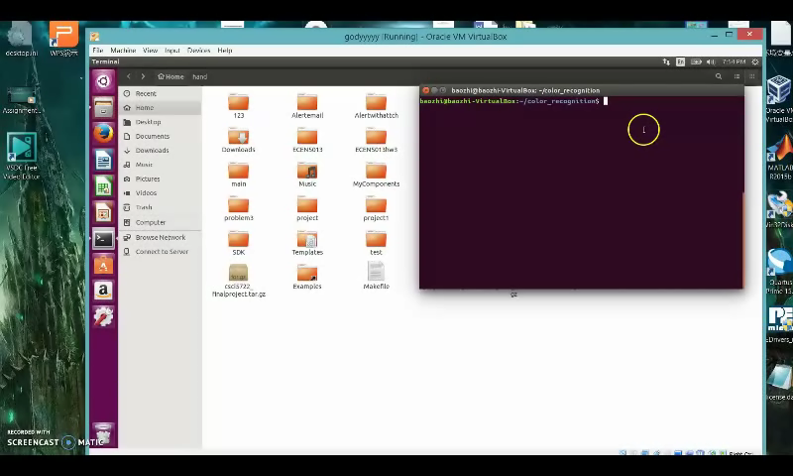
Video

Slide 4
RESULTS
Dataset : Yale university data set – 96,97,98
Number of people: 52
Total number of images: 7432
Clip limit | Grid size | Scalefactor | Minimum neighbour | Number of images Where faces detected | Number of images--smiles | Number of images-- eyes | Face Correct Prediction % | Smile correct prediction % | Eye Correct Prediction %
2 | 5,5 | 1.1 | 5 | 7060 | 237 | 5238 | 0.96 | 0.63 | 0.86
1.9 | 7,7 | 1.3 | 6 | 7048 | 61 | 5133 | 0.95 | 0.35 | 0.83
1.8 | 9,9 | 1.5 | 7 | 7044 | 40 | 5055 | 0.94 | 0.32 | 0.80
1.7 | 2,2 | 1.7 | 8 | 7123 | 19 | 5377 | 0.97 | 0.40 | 0.87
1.6 | 3,3 | 1.1 | 5 | 7117 | 125 | 5239 | 0.97 | 0.30 | 0.85

Slide 5
References
http://opencv.org/
http://blog.csdn.net/lg1259156776/article/details/50085045
http://blog.csdn.net/liuqz2009/article/details/47623399

Slide 6
THANK you drive link:https://drive.google.com/open?id=0B965WtzIU_oqaDJqcFRubHFITmc

